Slide 1
The Crucible
Character Introductions
By: Arthur Miller

Slide 2
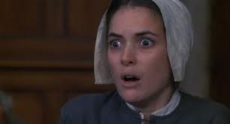
ABIGAIL WILLIAMS
Reverend Parris’s orphaned niece
About 16-years-old
Servant for the Proctors until Elizabeth Proctor fired her after discovering she was having an affair with her husband, John
Leader
Cunning/manipulative, and vengeful…a dangerous combination

Slide 3
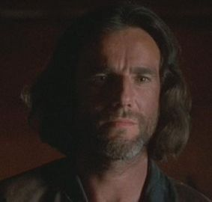
JOHN PROCTOR
The central character of the play
A farmer in his thirties
Elizabeth Proctor’s husband
Reputation of integrity and good sense
Noble and courageous, but not perfect (sins by committing adultery with Abigail, but repents)
Stern

Slide 4
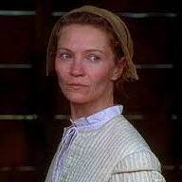
ELIZABETH PROCTOR
John Proctor’s wife
A good, honest woman
Loving and understanding, but sometimes cold
Fired Abigail upon discovering the affair she was having with her husband, John

Slide 5
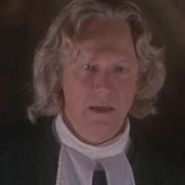
REVEREND PARRIS
Minister of Salem’s church
Paranoid and power-hungry
Greedy/Selfish
Overly concerned with his reputation in the community and security of his position
Most people in the town (especially John Proctor) dislike him because mostly concerned with himself and power

Slide 6
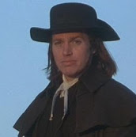
REVEREND JOHN HALE
Young minister from another town brought to Salem because of his expertise on studying witchcraft
Examines Reverend Parris’s daughter, Betty upon arrival
Voice of reason…his critical mind and intelligence keeps him from believing the ridiculous accusations
Regretful of executing the accused and attempts to save the rest of the innocent people accused

Slide 7
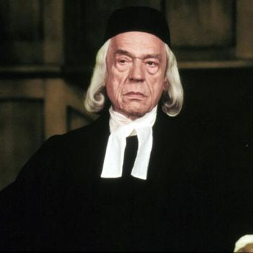
JUDGE DANFORTH
Religious and political leader in the community (authority of law and church…judge at Witch Trials)
Very serious about position – inflexible and unemotional (convinced he’s doing right0
Does not let the work of the court be questioned and lets the witch hunt continue (even though he knows innocent victims are being condemned)

Slide 8
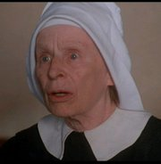
REBECCA NURSE
Wise and sensible woman
Extremely well-respected in Salem
Reverend Hale heard about her before he even arrived
Falls victim to hysteria when the Putnam’s accuse her of witchcraft and she refuses to confess that ridiculous lie
Mrs. Putnam resented her for birthing many healthy children

Slide 9
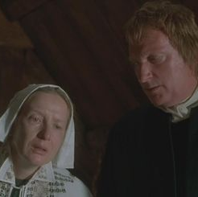
MR. AND MRS. PUTNAM
Bitter, jealous, small-minded, greedy couple
Thomas Putnam used the Witch Trials for his own gain by accusing people of witchcraft so that he can buy their land while they’re in jail
Ann Putnam gave birth to 8 children, but only one (Ruth) survived and she thinks they were murdered by “supernatural” means (Resents Rebecca Nurse for giving birth to many healthy children)

Slide 10
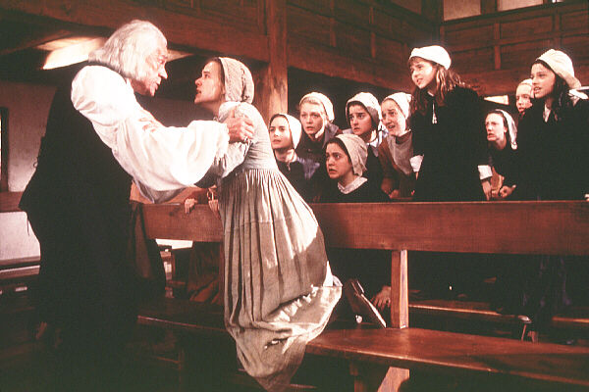
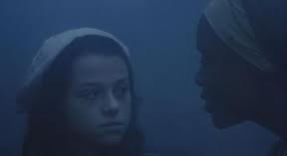
THE “AFFLICTED” GIRLS
The two girls in the beginning of the movie who are “afflicted” after Reverend Parris catches the all of the girls dancing in the woods
Betty Parris is Reverend Parris’s 10-year-old daughter
Ruth Putnam is Thomas and Ann Putnam’s daughter
Their illness fuel the first rumors about witchcraft

Slide 11
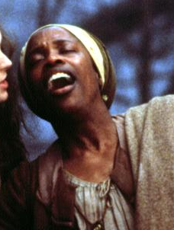
TITUBA
Reverend Parris’s black slave from Barbados
Agrees to perform “voo-doo” per Abigail’s request
Leads the girls’ “dancing” in the forest with her rituals from Barbados
One of the first people accused of witchcraft (by Abigail Williams)

Slide 12
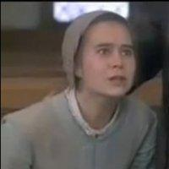
MARY WARREN
New servant in the Proctor household (after Abigail was fired)
Shy, weak, and easily influenced by the group of young girls
Tried to give a deposition that says the girls never saw any spirits, but recants the statement and lies to the court when all the girls are against her and she was intimidated

Slide 13
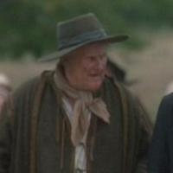
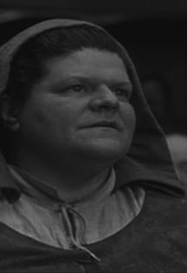
GILES AND MARTHA COREY
Neither believe the accusations the girls make
Giles is an elderly farmer in Salem, who is experienced in the courtroom
Giles is pressed to death by stones for “being in contempt of court” for not answering a question about who accused Putnam
His wife, Martha is accused of witchcraft and arrested because of her reading habits

